Slide 1
Lecture - 07

Slide 2
Stack Control
A stack is a sequence of storage locations that are accessible from only one end referred to as the top of the stack.
Two operations: Push and Pop.
Push or pop changes the position of the stack top by an amount that depends on the length of the operand pushed or popped.
A stack is controlled by an address register called the stack pointer SP. It contains the address of the new stack top.

Slide 3
Stack Control in Motorola 680X0
Motorola 680X0 has no explicit hardware for stack support. But its various addressing modes make it easy to treat any contiguous region of its external memory M as a stack.
Suppose the address register A2 of the 680X0 is designated as stack pointer and the stack grows toward the low addresses of M.
To push the content of D6 (data register) into the stack requires a single instruction MOVE.L D6, -(A2) which is equivalent to A2:=A2-4 and M(A2):=D6.
The pop instruction is MOVE.L (A2)+, D6 which is equivalent to D6:=M(A2) and A2:=A2+4

Slide 4
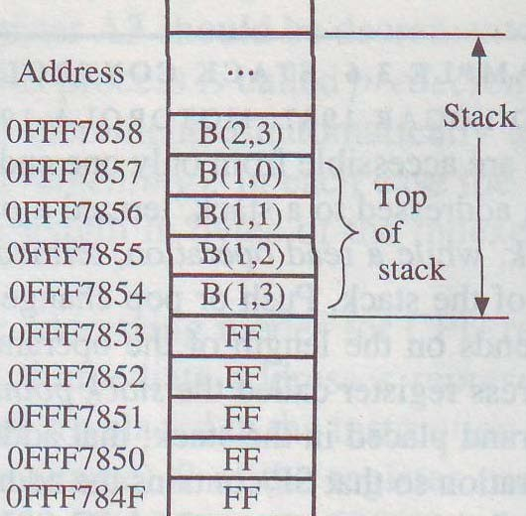
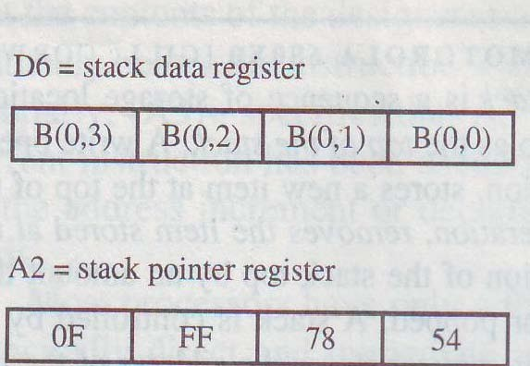
Stack Control in Motorola 680X0
Prior the execution of MOVE.L D6, -(A2)

Slide 5
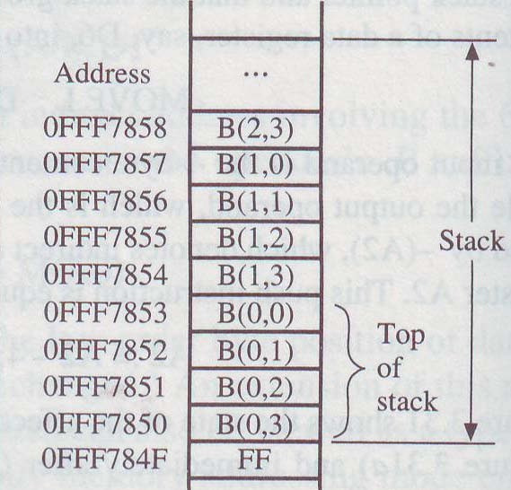
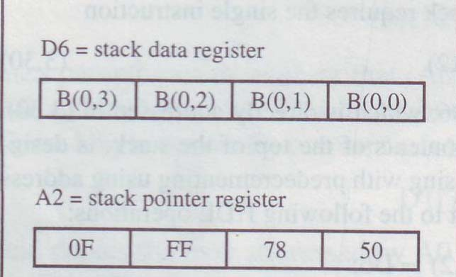
Stack Control in Motorola 680X0
After the execution of MOVE.L D6, -(A2)

Slide 6
Number of Addresses
Three-address instruction:
ADD Z, X, Y Z:= X+Y.
Two-address instruction:
ADD X, Y X:= X+Y.
One-address instruction:
ADD X AC:=AC+X.

Slide 7
Number of Addresses
Implement X:=A×B+C×C, where A, B, C and X are stored in the memory.
Instruction LOAD A MULTIPY B STORE T LOAD C MULTIPLY C ADD T STORE X
Comment
AC:=A
AC:= AC * B M(T):= AC AC:= C AC:=AC * C AC:= AC + T M(X) : = AC
One address machine
Instruction MOVE T, A MULTIPLY T, B MOVE X, C MULTIPLY X, C ADD X, T
Comment
T:=A
T:= T * B X:=C
X:= X * C X:=X+T
Two address machine
Instruction MULTIPLY T, A, B MULTIPLY X, C, C ADD X, X, T
Comment T:= A * B X:= C * C X:= X + T
Three address machine

Slide 8
Accumulator Architectures
Instruction set:
add A, sub A, mult A, div A, . . . load A, store A
Example: A*B - (A+B*C)
load B mul C add A store D load A mul B sub D
B
B*C
A+B*C
A+B*C
A
A*B
A*B-(A+B*C)

Slide 9
Accumulator Architecture : Pros and Cons
Pros
Very low hardware requirements
Easy to design and understand
Cons
Accumulator becomes the bottleneck
Little ability for parallelism or pipelining
High memory traffic

Slide 10
Zero Address Machine (Stack Based Architecture)
Addresses are eliminated by storing operands in a push-down stack.
All the operands are required to be in the top locations in the stack.
Stack pointer automatically keeps track of the stack top.
Push and pop operations are needed to transfer data to and from the stack.
For example, X+Y is invoked by ADD that causes the top two operands, which should be X and Y, to be removed from the stack and added. The resulting sum X+Y is then placed at the top of the stack.

Slide 11
Stack Architectures
Example: A*B - (A+C*B)
push A push B mul push A push C push B mul add sub
A
B
A*B
A
C
A
A*B
B
C
A
A*B
B*C
A
A*B
A+B*C
result
A
A*B
A*B

Slide 12
Stack Architecture: Pros and Cons
Pros
implicit operand addressing. Maintained by top of the stack.
Low hardware requirements.
Cons
Stack becomes the bottleneck.
Little ability for parallelism or pipelining.
Data is not always at the top of stack when need, so additional instructions like POP and SWAP are needed.

Slide 13
The Requirements for Instruction Set
It should be complete. We should be able to construct a machine language program to evaluate any function that is computable using a reasonable amount of memory space.
It should be efficient. The frequently required functions can be performed rapidly using relatively few instructions.
It should be regular. The instruction set should contain expected opcodes and addressing modes.
The instruction should be compatible with those of existing machine.

Slide 14
Classification of Instruction
Data transfer instructions – Copy information. Example: load, store, move instruction.
Arithmetic instructions – Perform operations on numerical data. Example: add, sub, mul, div etc.
Logical instructions - Boolean and non-numerical operations. Example: AND, NOT etc.
Program control instructions – It change the sequence in which program are executed. Example: Branch instruction.
Input-Output (IO) instructions – It cause information to be transferred to or from external IO devices. Example: PRINT LINE.

